Slide 1
Project introduction Characterization of mutational processes affecting metastatic transformation in cancer and the impact of therapies
Laura Vo Ngoc
6 June, 2018

Slide 2
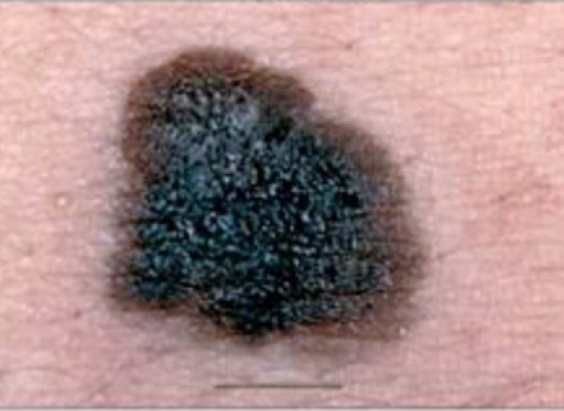
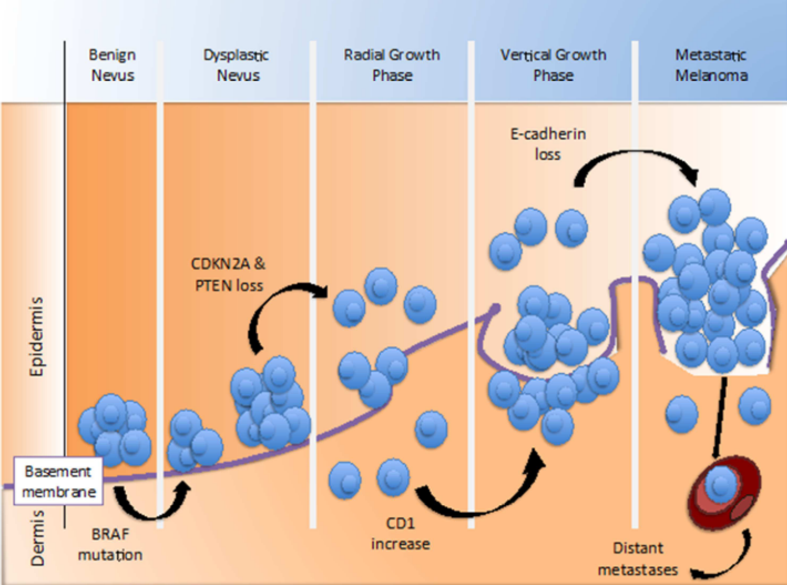
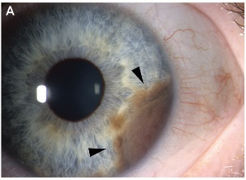
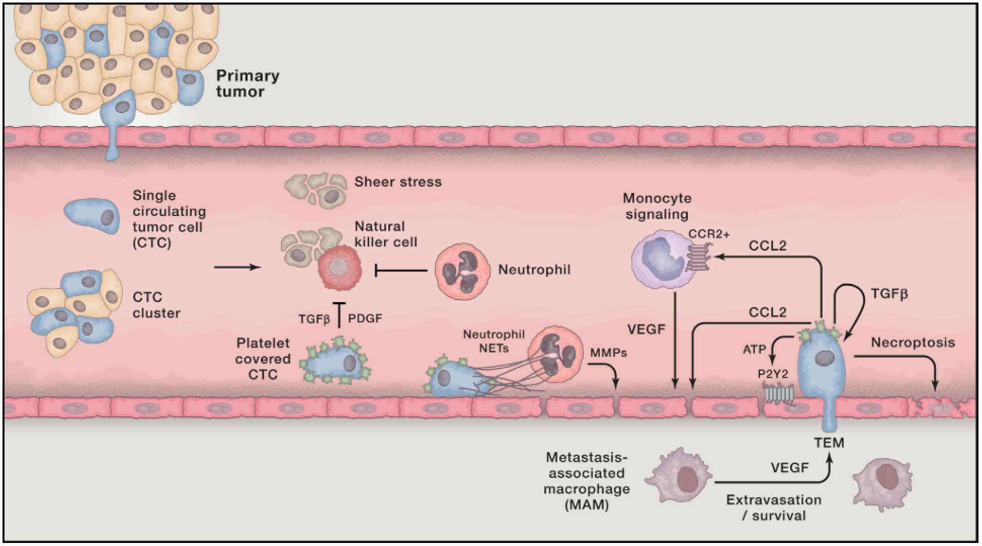
Background
Adapted from (Arrangoiz, 2016)
Cutaneous
Melanoma
Survival
63-90% (primary)
5-19% (metastatic)
3 major pathways
MAPK, PI3K/AKT, p16INK4A
Therapies:
Surgery, immunotherapy, targeted therapy, chemotherapy, radiation
Metastasis
Seeding
Immune recruitment
Colonization
Uveal
(Lambert, 2017)

Slide 3
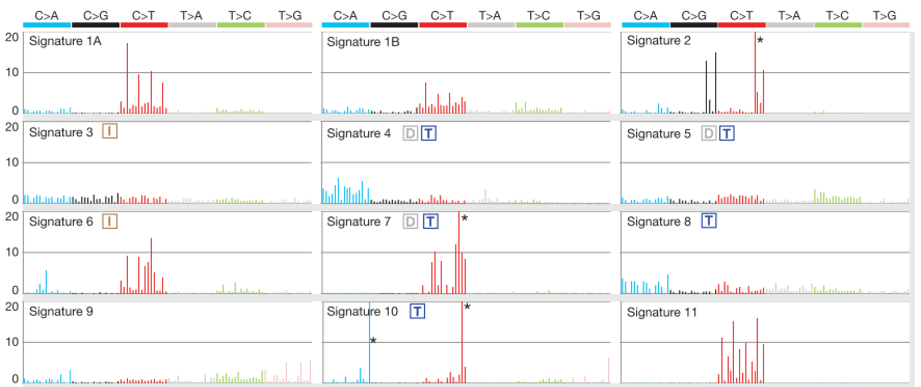
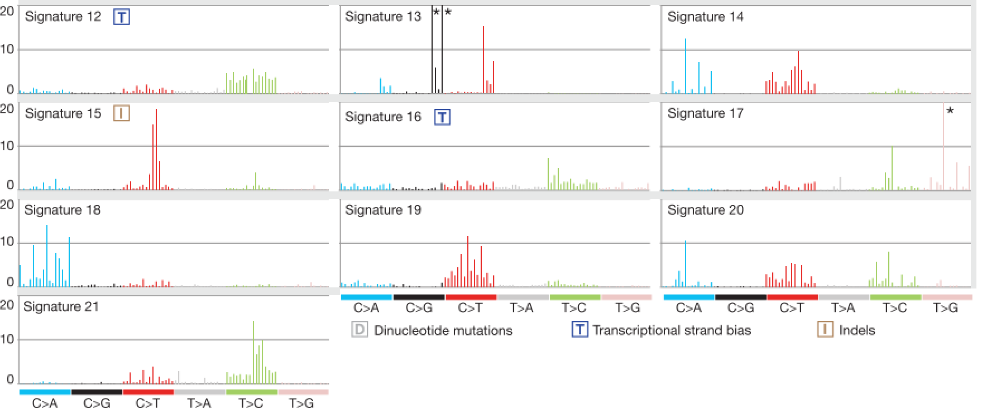
Background
Mutational signatures
(Alexandrov, 2013)
Aims
Investigate changes in mutational signatures
Disease progression (early metastatic transition)
Impact of different therapies

Slide 5
References
Alexandrov LB, Nik-Zainal S, Wedge DC, et al. Signatures of mutational processes in human cancer. Nature. 2013;500(7463):415-421.
Arrangoiz R. Melanoma Review: Epidemiology, Risk Factors, Diagnosis and Staging. J Cancer Treat Res. 2016;4(1):1.
Lambert AW, Pattabiraman DR, Weinberg RA. Emerging Biological Principles of Metastasis. Cell. 2017;168(4):670-691.
Sandru A, Voinea S, Panaitescu E, Blidaru A. Survival rates of patients with metastatic malignant melanoma. J Med Life. 2014;7(4):572-576.

